Slide 1


Slide 2


BSDG Discord!
Join our community to stay engaged
between events, and help drive
the content of future meetings

Slide 3
Web Scraping with Playwright & HAR Files
By Tom Day

Slide 4


InstaGram Giveaway!

Slide 5
Playwright
“an open-source framework for reliable end-to-end testing for modern web apps” - Microsoft
https://playwright.dev
https://2023.stateofjs.com/en-US/libraries/testing/#testing_ratios
https://learn.microsoft.com/en-us/training/modules/build-with-playwright/

Slide 6
Playwright Navigation
https://playwright.dev/docs/navigations
const browser = await playwright.chromium.launch();
const context = await browser.newContext();
const page = await context.newPage();
await page.goto('https://kcbs.us/');
The code above loads the page and waits for the web page to fire the load event. The load event is fired when the whole page has loaded, including all dependent resources such as stylesheets, scripts, iframes, and images.

Slide 7
Playwright Locators
https://playwright.dev/docs/locators
await page.getByLabel('User Name').fill('John');
await page.getByLabel(‘Password').fill('secret-password');
await page.getByRole('button', { name: 'Sign in' }).click();
await expect(page.getByText('Welcome, John!')).toBeVisible();

Slide 8
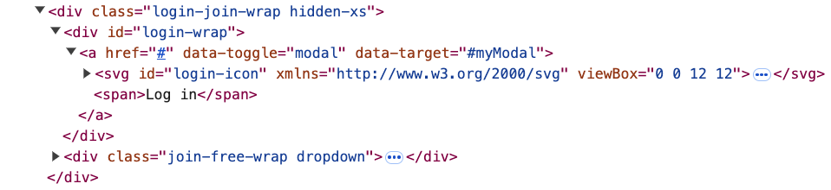
Playwright Locators
await page.locator(‘#login-wrap > a‘).click();

Slide 9
Playwright Locators Example
scrape-kcbs-toy.ts Walkthrough

Slide 10
Playwright Forms
await page.getByLabel('User Name’).fill(`${username}`);
await page.getByLabel(‘Password').fill(`${password}`);
await page.getByRole('button', { name: 'Sign in' }).click();
await page.fill("[name=username]", `${username}`);
await page.fill('[type="password"]', `${password}`);
await page.click("[type=submit]");

Slide 11
Playwright Forms Example
scrape-kcbs-events.ts Walkthrough

Slide 12
Playwright Scroll Example
// Locate with RegEx
const followersLink = page.getByText(/[0-9,.KM]+ followers/i);
await followersLink.click();
// Locate the second dialog
const followersDialog = page.getByRole(‘dialog’).nth(1);
// Locate within another locator
await followersDialog
.locator(‘div:visible’)
.last()
.hover();
// Scroll down (x, y)
await page.mouse.wheel(0, 100);

Slide 13
Playwright Interaction Example
scrape-ig-followers.ts Walkthrough

Slide 14
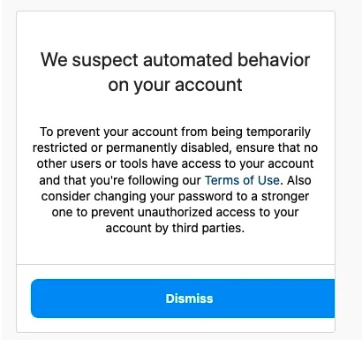
It Really Works!

Slide 15
Playwright Connect Through CDP
https://playwright.dev/docs/api/class-browsertype#browser-type-connect-over-cdp
Attaches Playwright to an existing browser instance using the Chrome DevTools Protocol.
Must start browser with debugger enabled.

Slide 16
Playwright CDP Example
scrape-ig-followers-cdp.ts Walkthrough

Slide 17
HAR Files
“The HTTP Archive format, or HAR, is a JSON-formatted archive file format for logging of a web browser's interaction with a site. The common extension for these files is .har.” - Wikipedia
https://en.wikipedia.org/wiki/HAR_(file_format)

Slide 18
HAR File Example
Capture IG followers interaction.

Slide 19
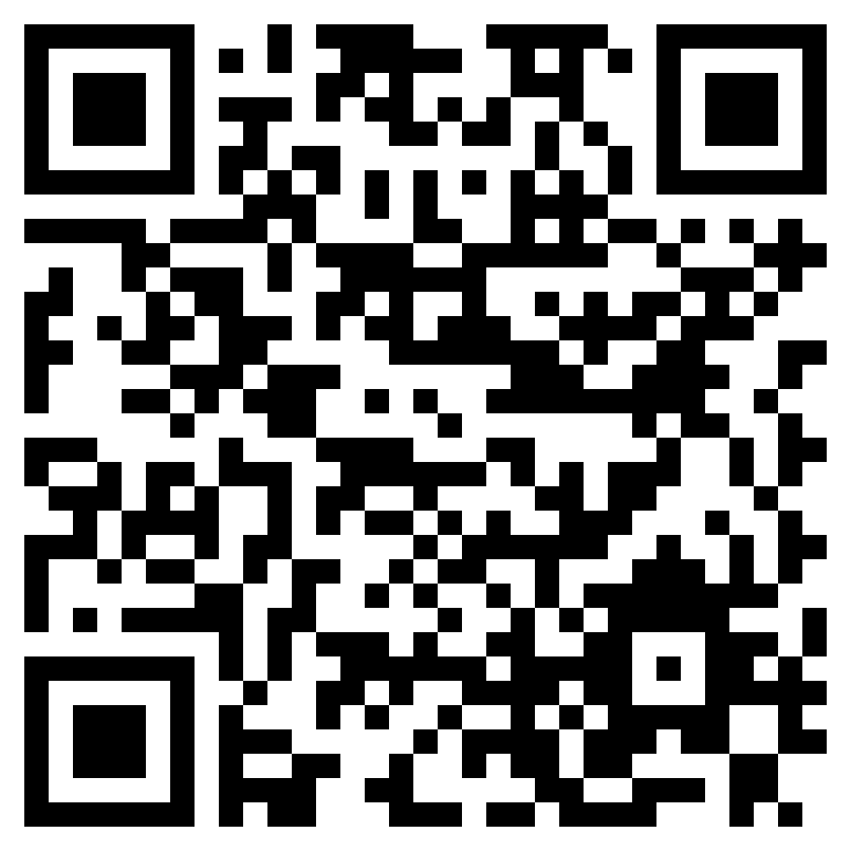
Questions
https://github.com/MeshSoftware/playwright-web-scraping

